Slide 1

7th Semester
Project Presentation
on
Missing Person Detection System
Presented by
Priyanshu Panda (Regd. No. : 20UG010312)
Sarin Kumar Sahu (Regd. No. : 20UG010328)
Akash Kumar Mohanty (Regd. No. : 20UG010334)
Under the guidance of
Miss Alisa Behera
Asst Professor, Department of CSE, GIET University
Gandhi Institute of Engineering and Technology University
26th April 2024

Slide 2

A Project Presentation on
“Missing Person Detection System”
Outline
Introduction
Project Overview
Technology Stack
System Design
Future Scope
Benefits and Impact
Challenges and Mitigations
Conclusion
Q&A

Slide 3
A Project Presentation on
“Missing Person Detection System”
Introduction
Agriculture forms the backbone of India's economy, with millions of farmers relying on traditional methods and practices to cultivate crops and sustain their livelihoods.
However, farmers often face numerous challenges, including pest infestations, soil nutrient deficiencies, market uncertainties, and limited access to relevant information and resources.
In response to these challenges, the Krishi Sahayak project has been initiated to revolutionize agricultural practices by leveraging advanced technologies and data-driven solutions.

Slide 4

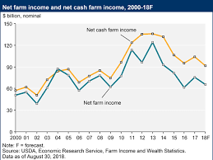
A Project Presentation on
“Missing Person Detection System”

Slide 5
A Project Presentation on
“Missing Person Detection System”
Project Overview
Objectives:
Provide timely information and personalized recommendations to farmers.
Enhance agricultural productivity and sustainability.
Improve access to essential resources and market insights.
System Features:
Pest prediction using CNN models.
Kriging for fertilizer recommendation.
Crop recommendation based on machine learning algorithms.
Real-time market statistics and government MSP information.
Multilingual support and access to agricultural news.

Slide 6
A Project Presentation on
“Missing Person Detection System”
Project Overview
Multilingual support and access to agricultural news.
Fertilizer shop locator for convenience.
Integration of IoT devices for real-time monitoring (future scope).
Incorporation of blockchain technology for transparent supply chain management (future scope).

Slide 7
A Project Presentation on
“Missing Person Detection System”
Technology Stack
Languages Used:
Python
Flask
HTML/CSS/Javascript/Bootstrap
Libraries:
tensorflow
Keras
CNN
IDE:
VsCode

Slide 8
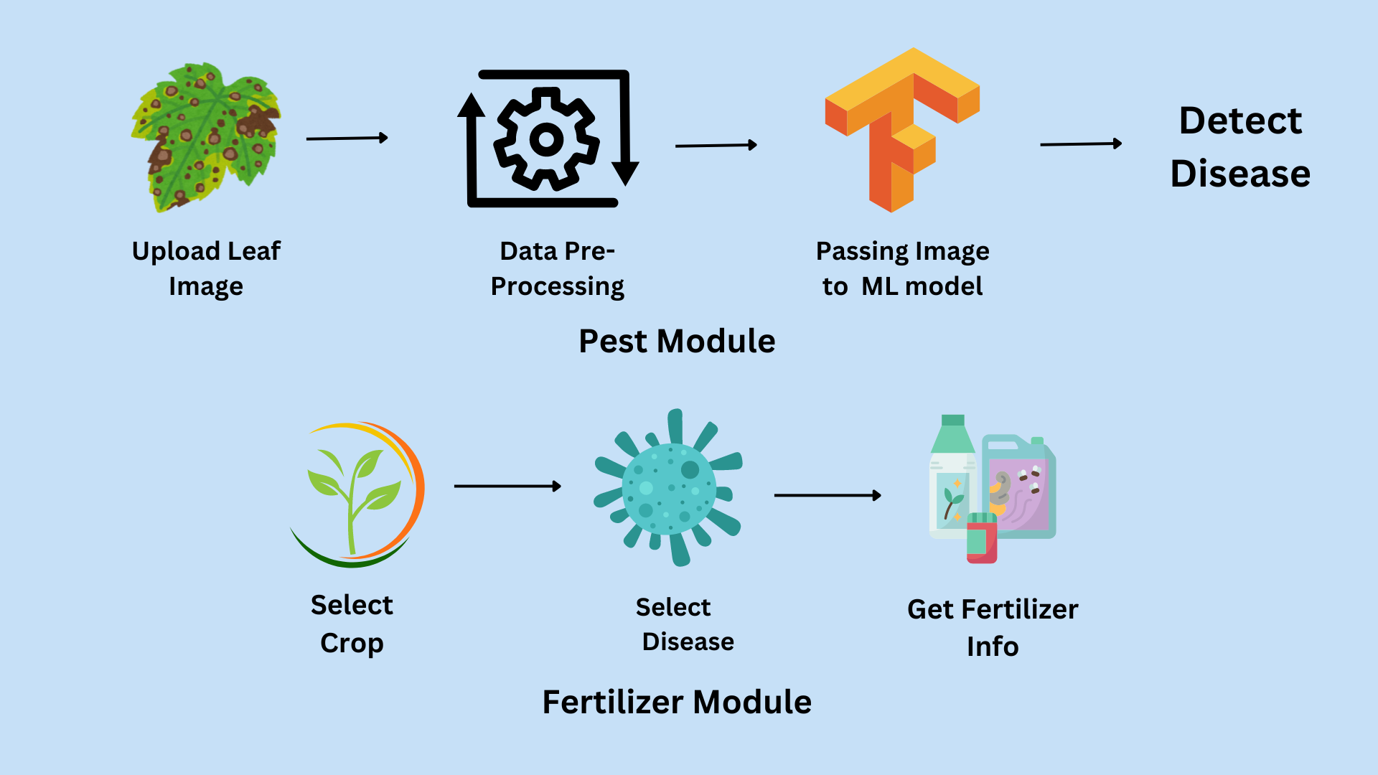
A Project Presentation on
“Missing Person Detection System”
System Design

Slide 9
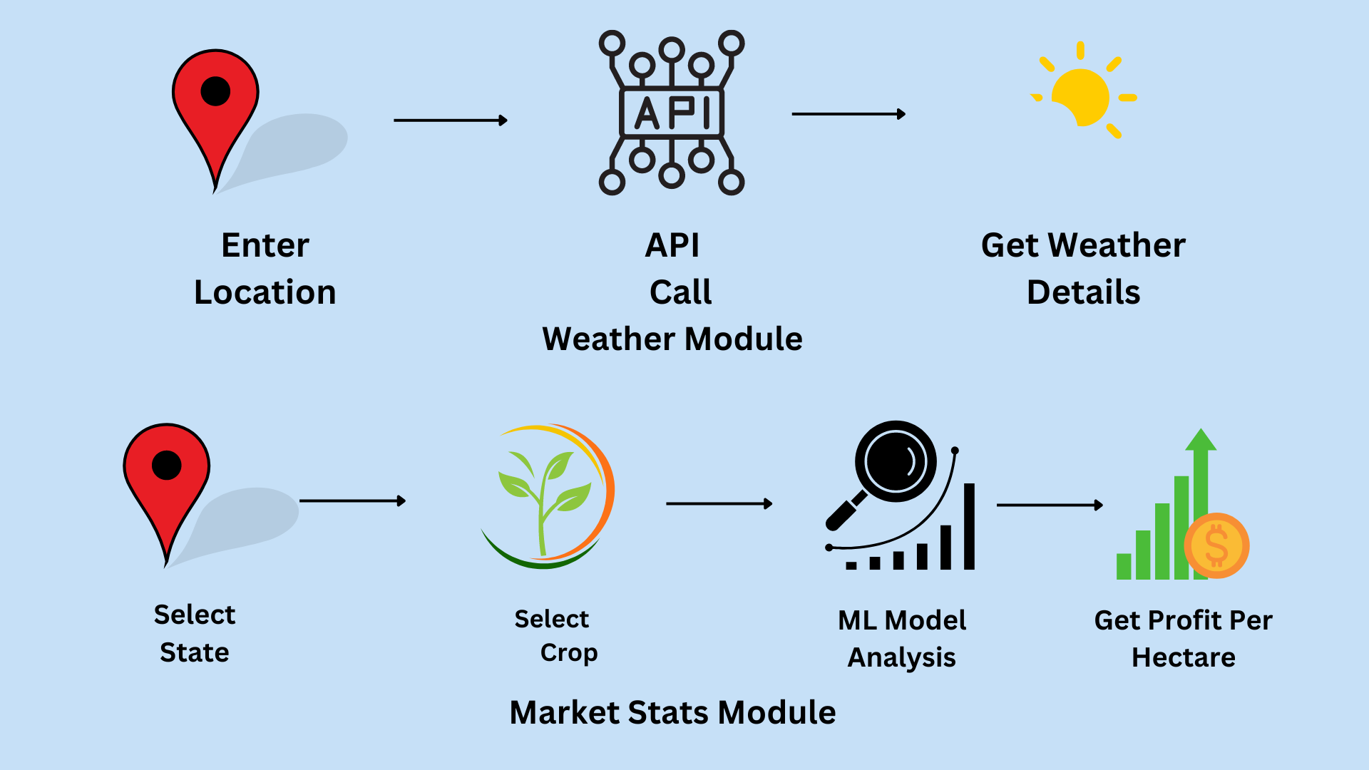
A Project Presentation on
“Missing Person Detection System”
System Design

Slide 10
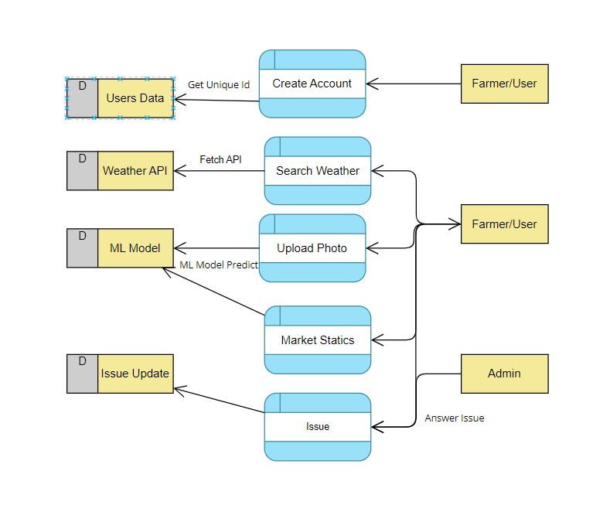
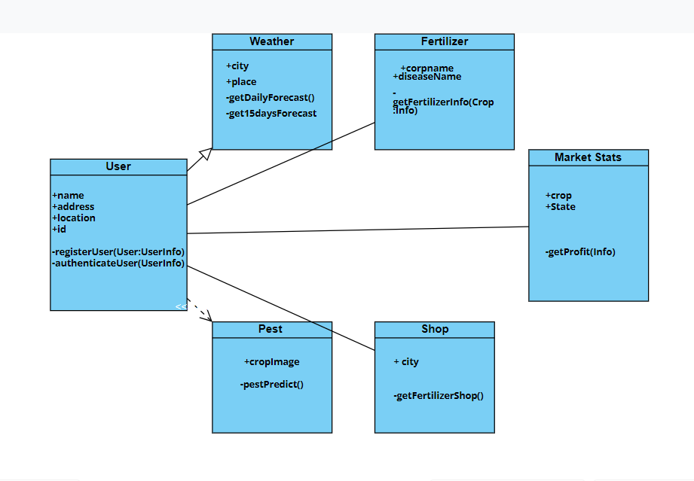
A Project Presentation on
“Missing Person Detection System”
System Design

Slide 11
A Project Presentation on
“Missing Person Detection System”
Future Scope
Real-Time Video Analysis Integration.
Mobile Application Development.
Collaboration with Law Enforcement Agencies,
Integration with Social Media Platforms.
Integration with Public Services.
Implementing encryption protocols and data privacy.
Incorporating geolocation services and camera metadata.
Deploying the system on cloud services like AWS, Azure, or Google Cloud.

Slide 12
A Project Presentation on
“Missing Person Detection System”
Benefits and Impact
Increased crop yields through personalized recommendations.
Enhanced pest management leading to reduced crop losses.
Improved soil fertility with optimized fertilizer usage.
Access to real-time market statistics for informed decision-making.
Multilingual support for wider accessibility among farmers.
Convenient fertilizer shop locator for easy procurement.
Empowerment of farmers through comprehensive agricultural assistance.
Future scalability with integration of IoT and blockchain technologies.

Slide 13
A Project Presentation on
“Missing Person Detection System”
Challenges & Mitigations
Challanges
Limited technological literacy among farmers.
Variability in regional agricultural practices and requirements.
Data accuracy and reliability in rural areas.
Accessibility to internet connectivity and mobile devices.
Resistance to change from traditional farming methods.
Integration of diverse data sources for accurate predictions.
Ensuring affordability and sustainability of recommended practices.

Slide 14
A Project Presentation on
“Missing Person Detection System”
Challenges & Mitigations
Mitigations
Conducting farmer training programs on technology usage.
Customizing recommendations based on regional conditions.
Implementing data validation mechanisms and feedback loops.
Developing offline functionalities for remote areas.
Providing incentives and education for adopting new practices.
Collaborating with agricultural research institutes for data validation.
Offering subsidies and incentives for adoption of recommended practices.
Continuous monitoring and refinement of prediction models.

Slide 15
A Project Presentation on
“Missing Person Detection System”
Conclusion
Krishi Sahayak represents a transformative solution for the agricultural sector in India.
Through the integration of technology and data-driven approaches, Krishi Sahayak addresses key challenges faced by farmers.
The platform offers personalized recommendations, timely information, and access to essential resources.
Modules such as pest prediction, fertilizer optimization, and market insights empower farmers to make informed decisions.
Krishi Sahayak aims to enhance agricultural productivity, sustainability, and livelihoods across the country.
Moving forward, Krishi Sahayak remains committed to innovation, collaboration, and positive impact in Indian agriculture.

Slide 16
A Project Presentation on
“Missing Person Detection System”
THANK YOU!!

